Slide 1
Deep Neural Networks for
Text Classification
Aniruddha Shamasundar(ashamas)
Chinmai Kaidabettu Srinivas(ckaidab)
Siddu Madhure Jayanna(smadhur)

Slide 2
Problem Statement
Develop, compare and analyse performance of 3 different Deep Neural Networks for text classification
Convolutional Neural Network (CNN)
Recurrent Neural Network (RNN)
Hierarchical Attention Network (HAN)
Use word vectors generated by Google’s GloVe as an underlying data model to get the vector embeddings for our data set

Slide 3
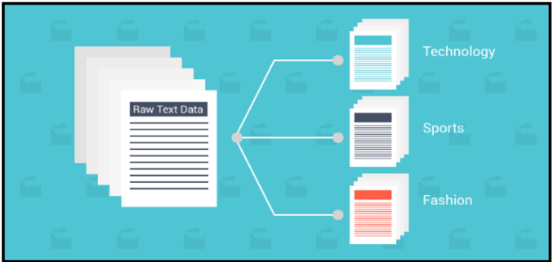
Dataset
News Category Dataset
Consists of 200k news headlines from the year 2012 to 2018 obtained from HuffPost.
Consists of 41 different news categories.
Sample Dataset
{
"category": "CRIME",
"headline": "There Were 2 Mass Shootings In Texas Last Week, But Only 1 On TV",
"authors": "Melissa Jeltsen", "link":"https://www.huffingtonpost.com/entry/texas-amanda-painter-mass-shooting_us_5b081ab4e4b0802d69caad89",
"short_description": "She left her husband. He killed their children. Just another day in America.",
"date": "2018-05-26"
}

Slide 4
Dataset preprocessing- 1
Reduced 41 categories to 20 news categories by:
Merging related categories to a single category
Combined short description along with news headline to give descriptive news headline
Sequence encoding
Formatted our text samples into number sequences to feed it to neural network
Utilize
keras.preprocessing.text.Tokenizer
Keras.preprocessing.sequence.pad_sequences

Slide 5
Dataset preprocessing- 2
4) Creation of Embedding Layer using GloVe
Compute an index mapping of words to vector embeddings
Use the above vector embeddings to create an embedding layer
5) Convert each of the 20 categories into a vector of 20-dimensions
Use one hot encoding technique.

Slide 6
DNN models
We have built and analyzed the following deep neural networks
Convolutional Neural Networks (CNN)
Recurrent Neural Networks (RNN)
Hierarchical Attention Networks (HAN)

Slide 7
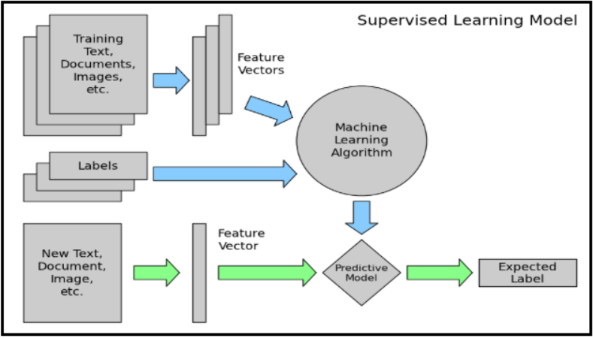
Flow Diagram

Slide 8
Convolutional Neural Networks
Convolutional layer is used to identify special pattern in text data
Use different sized kernels to identify patterns of different sizes
Identifies patterns regardless of the position of words
Use Max Pooling Layer to reduce the spatial size of the data representation
Use Dropout layer to avoid overfitting
Use Dense layer with softmax activation function to classify the news headline

Slide 9
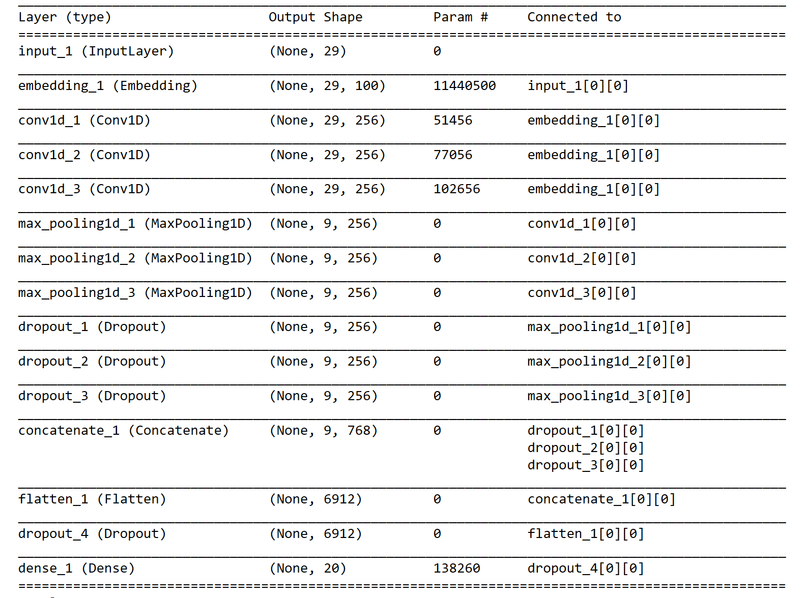
CNN Model Summary

Slide 10
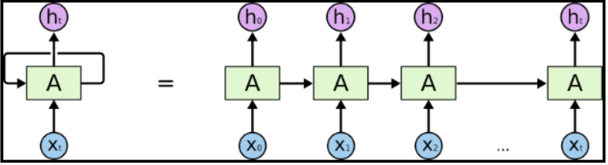
Recurrent Neural Networks
Overcomes shortcoming of traditional NN in dealing with sequence data
Integrates lexical and semantic information
Layers Involved:
Use Spatial Dropout layer to perform variational dropout in text models
Use LSTM layer to retain last output in RNN
Use Dense layer with softmax activation function for multi-class text classification

Slide 11
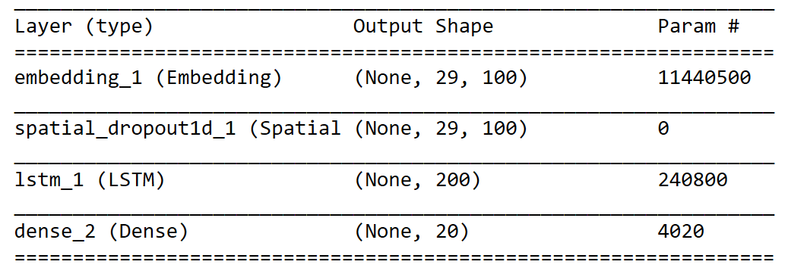
RNN Model Summary

Slide 12
Hierarchical Attention Networks
Main idea - words make sentences and sentences make documents
Preprocess data and construct 3D Matrix in order to cater the needs of HAN architecture
First Dimension represents total number of documents.
Second Dimension represents number of sentences in a document
Third dimension represents number of words in a sentence
Layers Involved:
Use bidirectional LSTM layer to incorporate contextual information
Use Time Distributed layer to apply a layer to every temporal slice of input
Use Attention layer to:
Apply attention mechanism at word level and sentence level
Enables to attend more and less important content during document representation
Use Dense layer with softmax activation function for multi-class text classification.

Slide 13
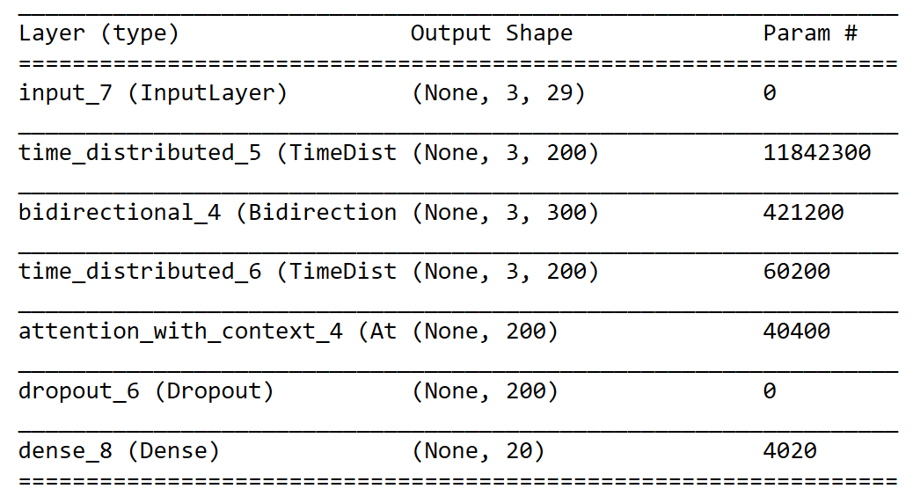
HAN Model Summary

Slide 14
Tuning Hyperparameters
Learning rate
Batch size
GloVe embedding dimensions
Number of epochs
Maximum number of words in a sentence for each model
Number of layers in each model
Number of filters for CNN
Kernel size for max pooling in CNN
Number of cells for LSTM layer in RNN
Maximum number of sentences considered in HAN
Dropout percentage

Slide 15
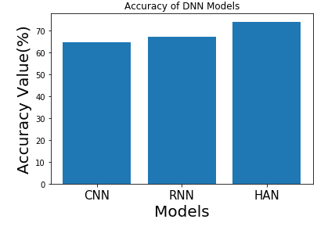
Results
The accuracy rate of CNN: 64.75%
The accuracy rate of RNN: 67.01%
The accuracy rate of HAN: 74.05%

Slide 16
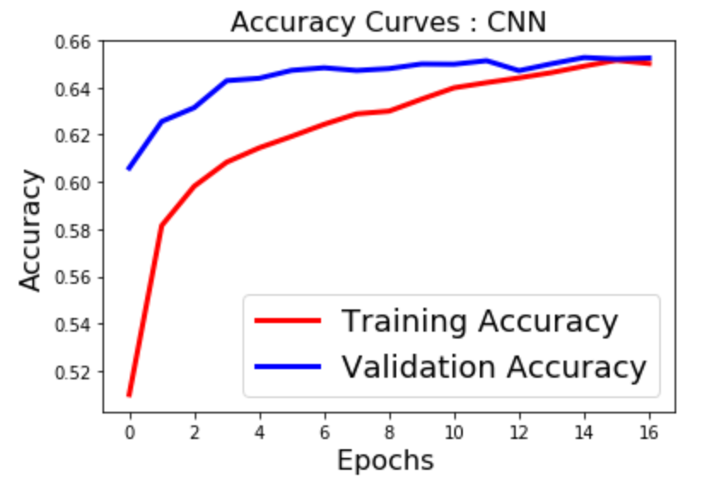
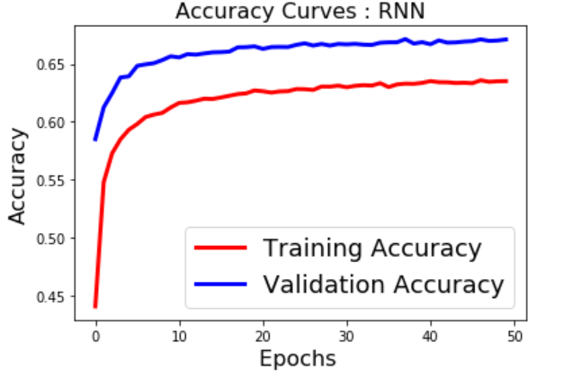
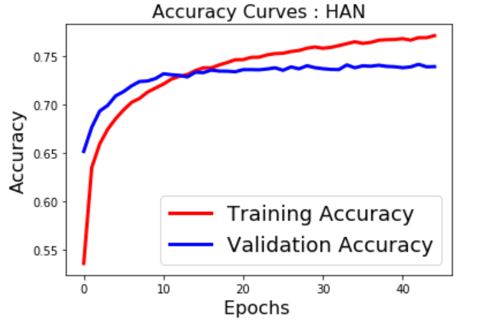
Analysis and Conclusion

Slide 17
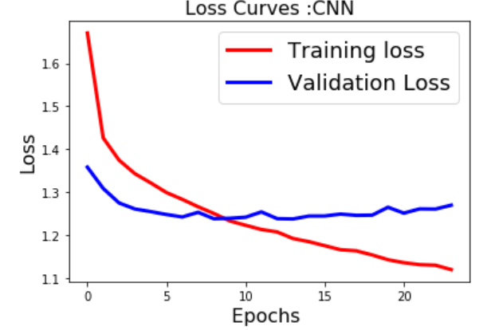
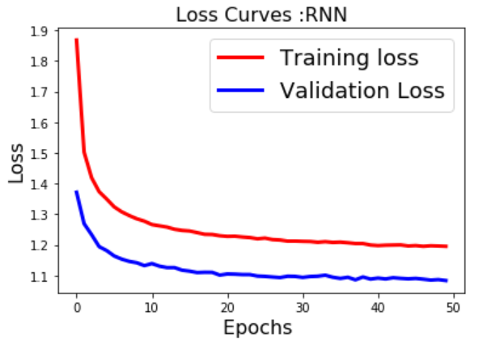
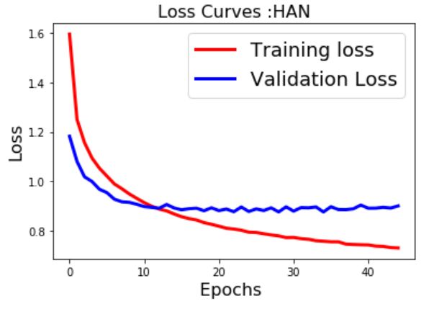
Contd..
Performance: HAN > RNN > CNN
However, CNN model has outperformed the other two models (RNN & HAN) in terms of training time.

Slide 18
References
https://www.cs.cmu.edu/~./hovy/papers/16HLT-hierarchical-attention-networks.pdf
https://blog.keras.io/using-pre-trained-word-embeddings-in-a-keras-model.html
https://www.aclweb.org/anthology/W18-5408
https://towardsdatascience.com/multi-class-text-classification-with-lstm-1590bee1bd17
https://medium.com/analytics-vidhya/hierarchical-attention-networks-d220318cf87e

Slide 19
Thank You

